Slide 1
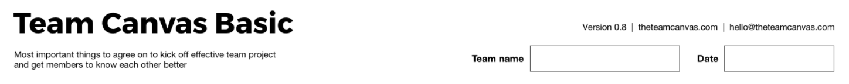
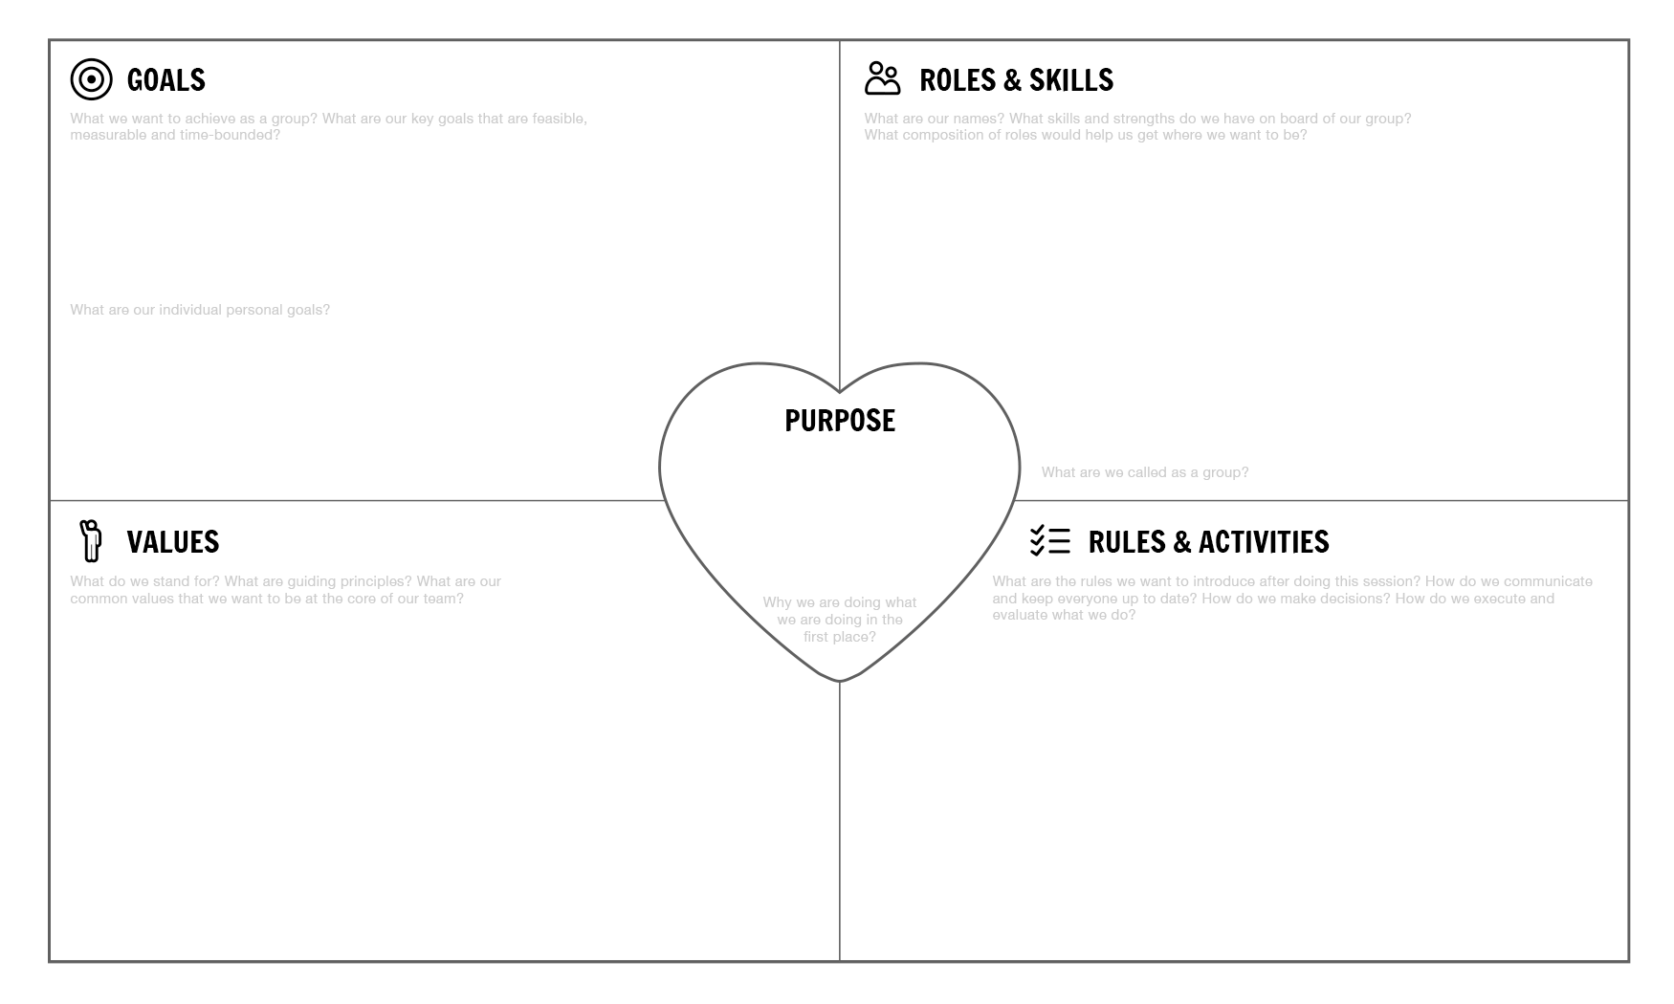
Goals:
What are the goals for the entire team and for each team member?
Roles & competencies:
What are the roles and the corresponding skills and competencies that each member brings to the table?
Values:
What are the core values that you share as a team?
Rules and activities
What are the ground rules you want to agree on? How will you communicate? How will you make decisions? How will you plan, execute and evaluate?
Purpose:
What is the purpose of the team: the why behind your goals?

Slide 2
